Slide 1
Sales Prediction Model
Machine Hack Competition

Slide 2
Agenda
Exporting the required data
Data Preprocessing
Model selection
Model deployment
Model performance result
Model Insight

Slide 3
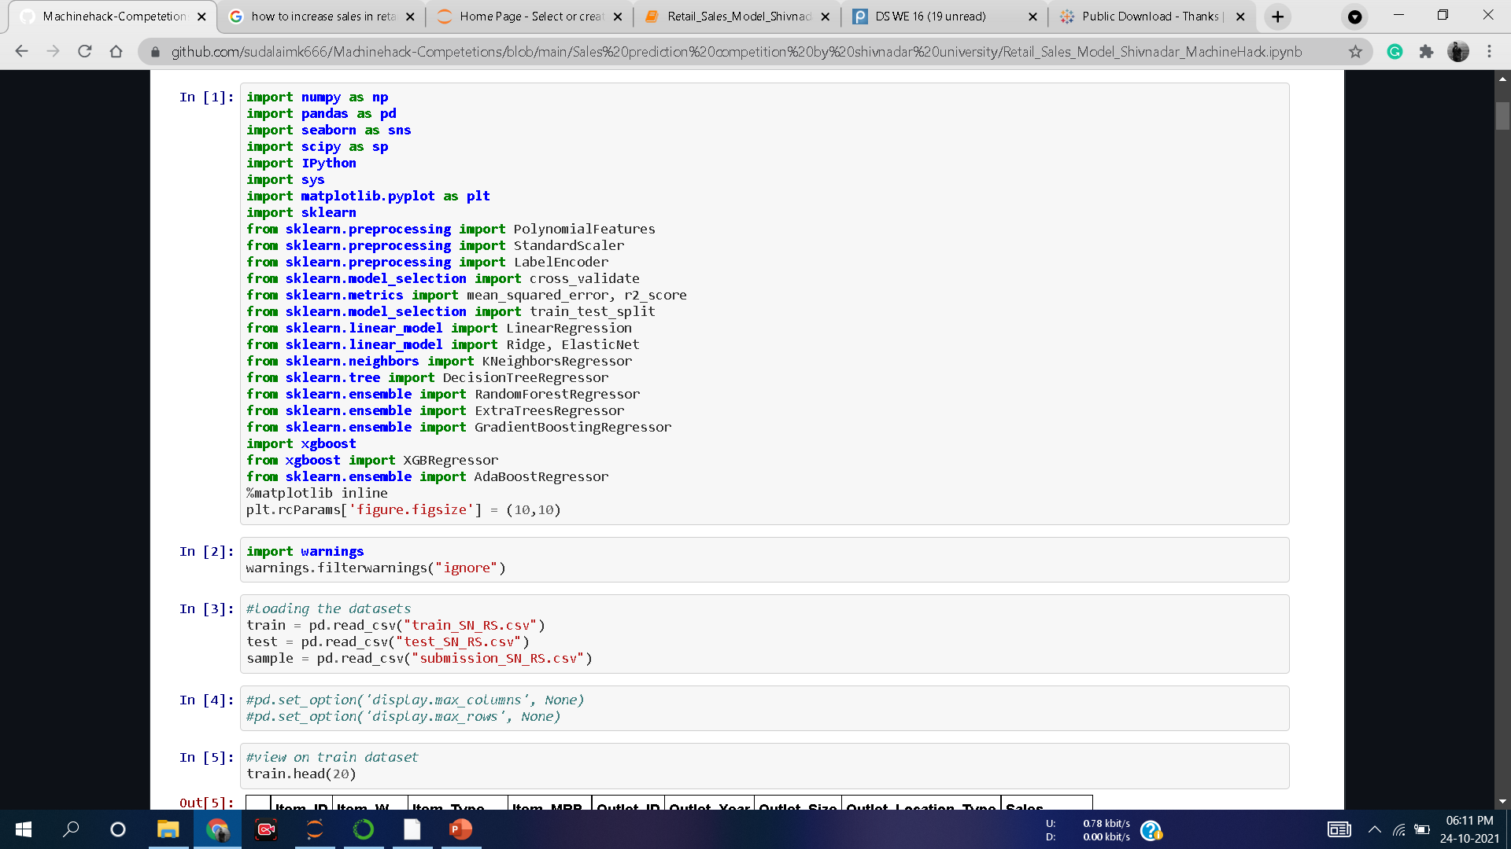
Exporting the Data

Slide 4
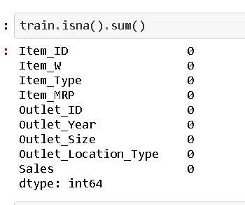
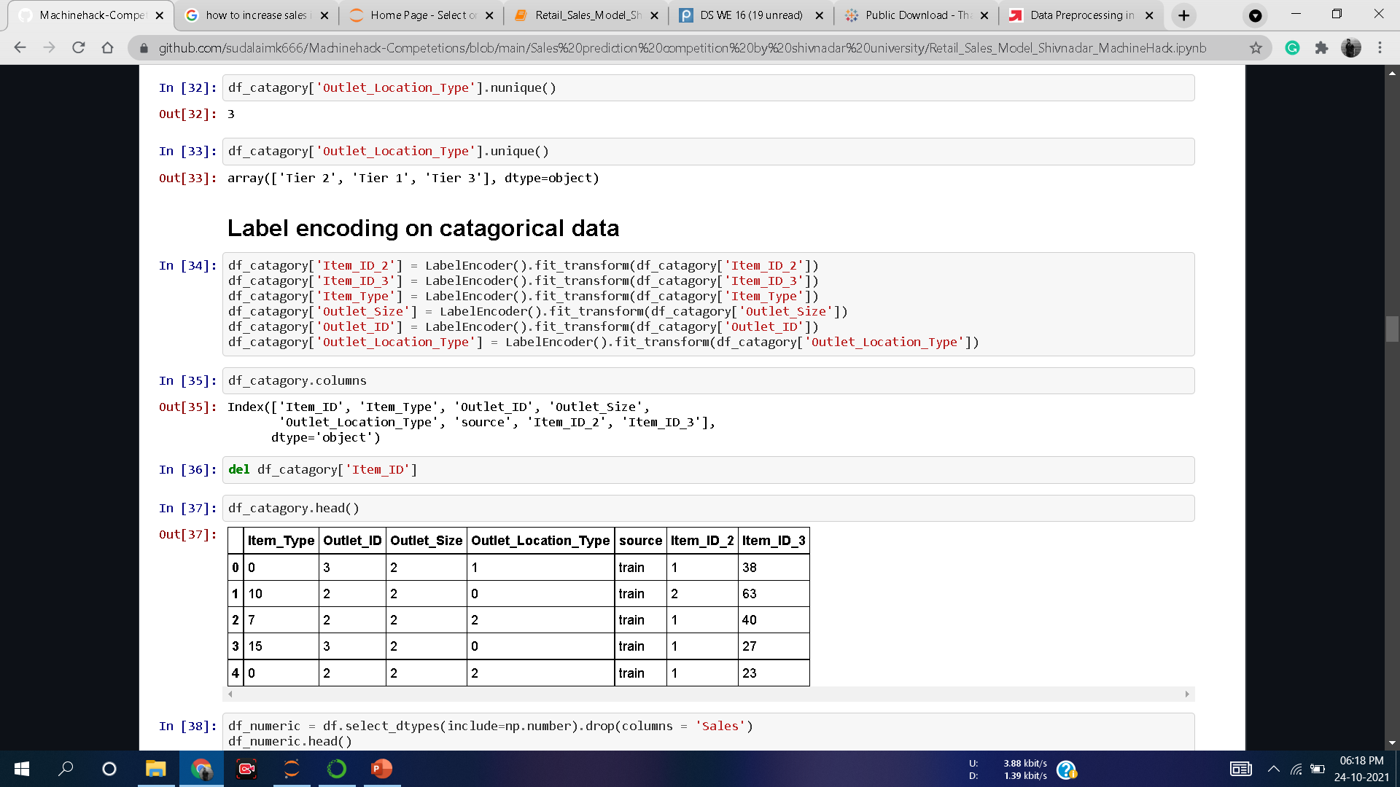
Data preprocessing
Data cleaning – check for duplicates
Identifying and handling the missing values
Encoding the categorical data

Slide 5
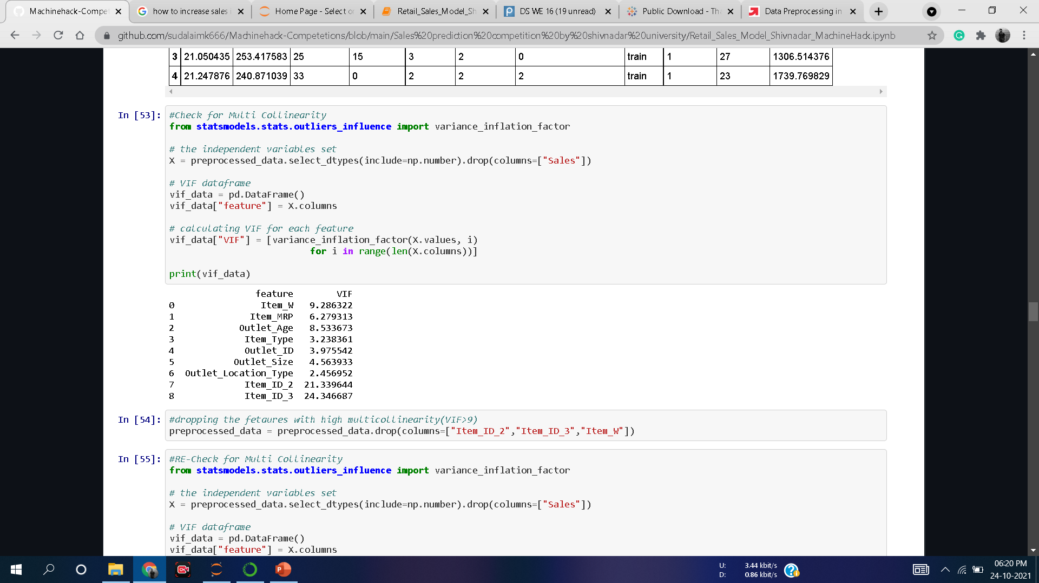
In preprocessed data checking for multi collinearity
Dropping values greater than VIF>9

Slide 6
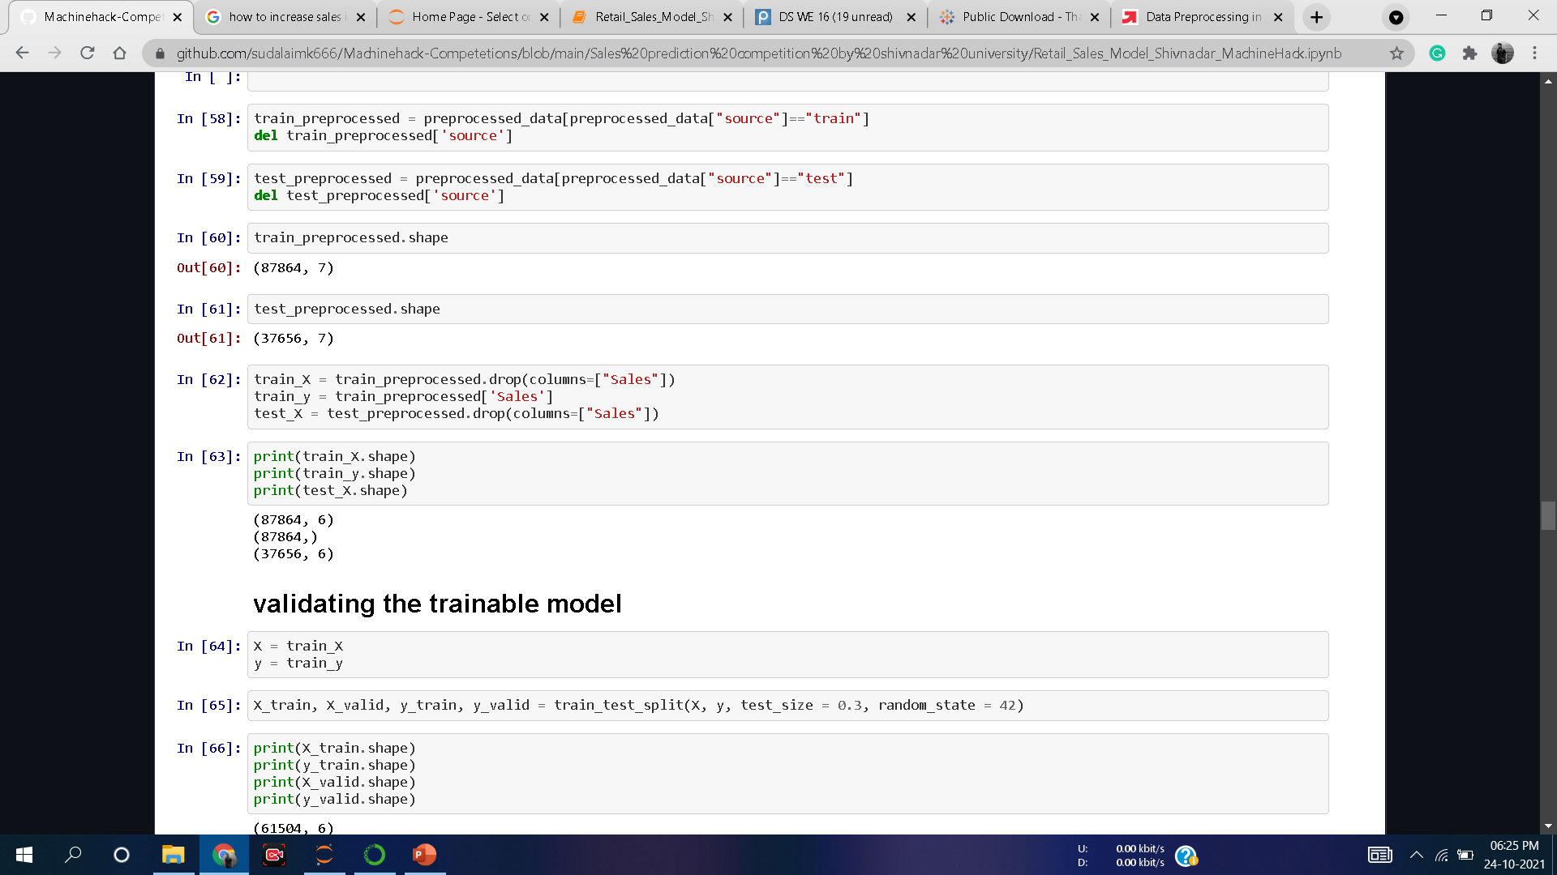
SPLITTING THE PREPROCESSED TRAIN AND TEST DATA

Slide 7
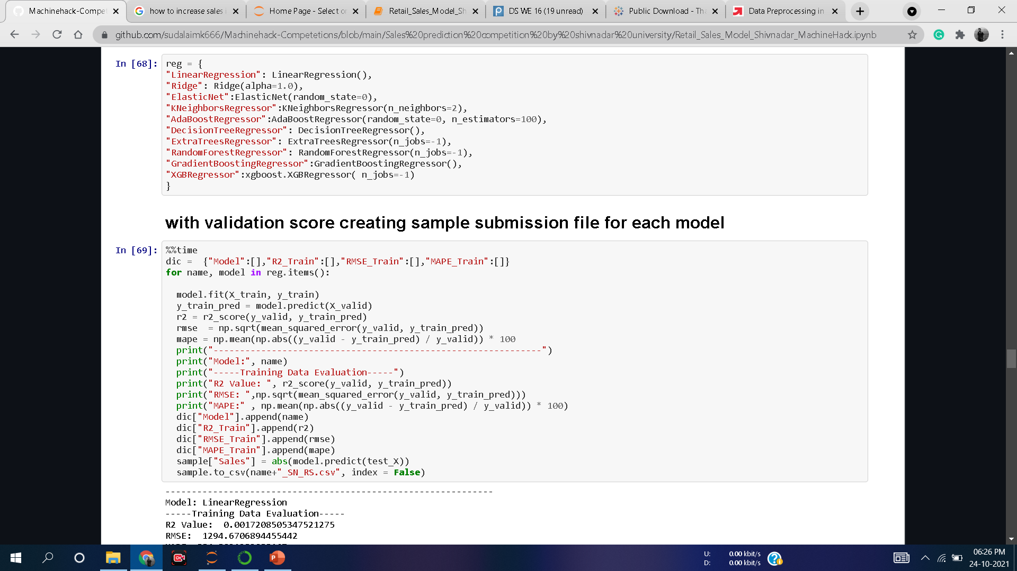
MODEL SELECTION - 1

Slide 8
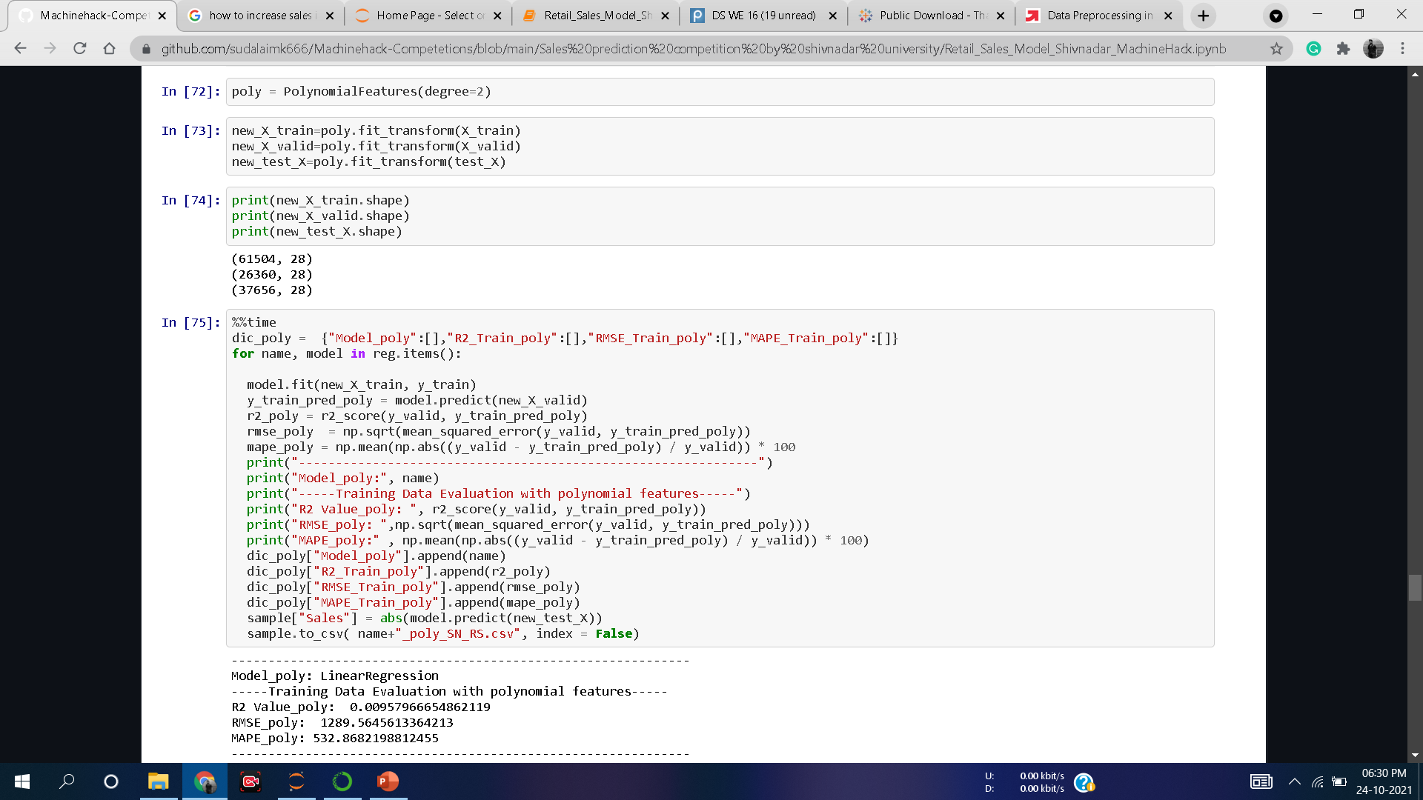
MODEL SELECTION - 2
WITH POLYNOMIAL FEATURES

Slide 9
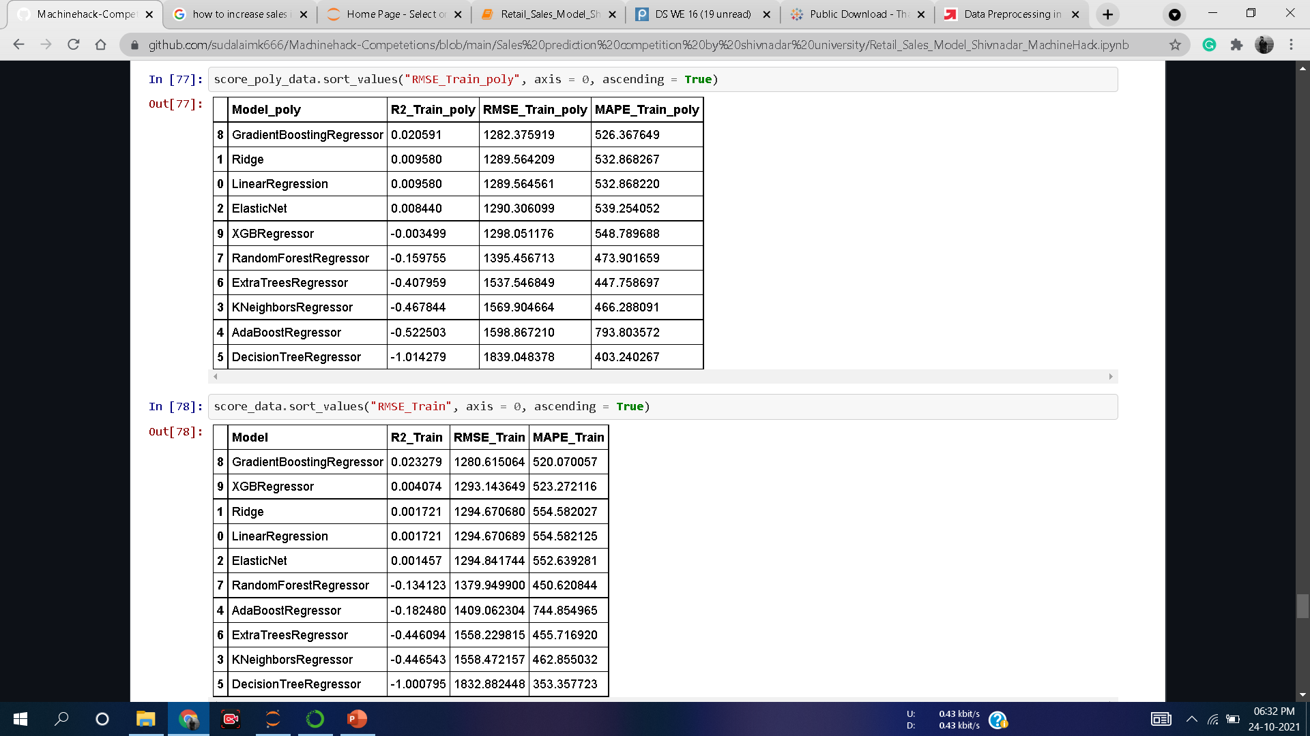
SCORES OF THE ABOVE TWO MODELS

Slide 10
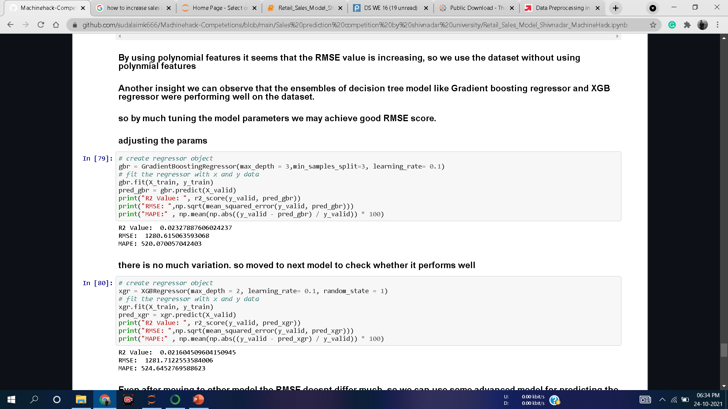
MODEL DEPLOYMENT

Slide 11
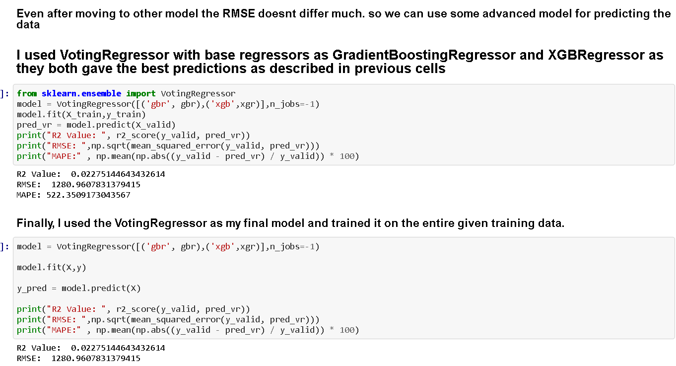
FINAL MODEL

Slide 12
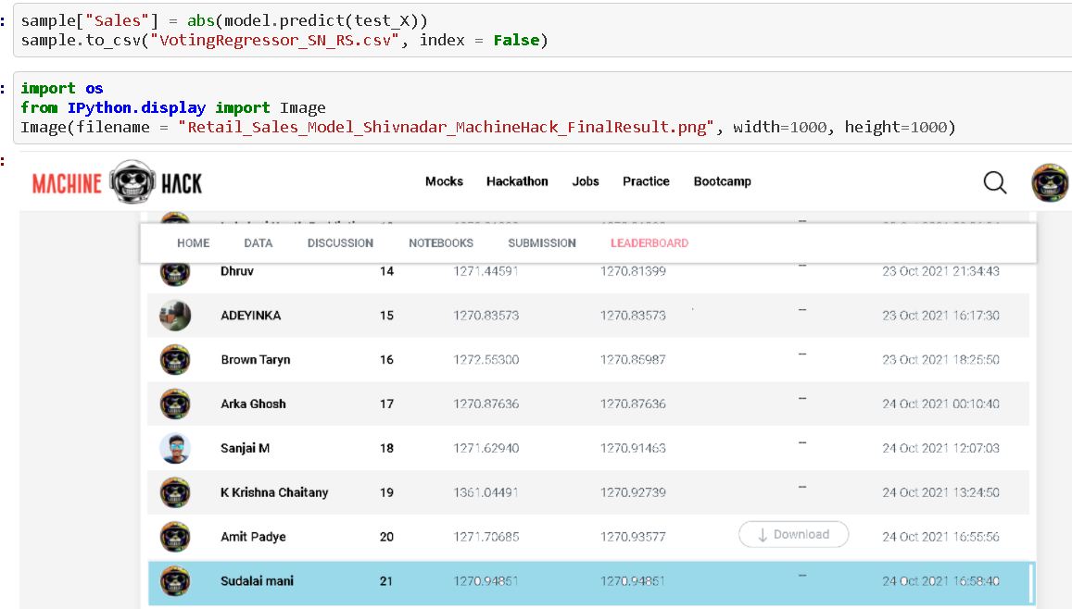
COMPETITION RANK - 21

Slide 13
THANK YOU
GitHub link: https://github.com/sudalaimk666/Machinehack-Competetions/blob/main/Sales%20prediction%20competition%20by%20shivnadar%20university/Retail_Sales_Model_Shivnadar_MachineHack.ipynb

